Slide 1
Adding a Bootstrap Card

Slide 2
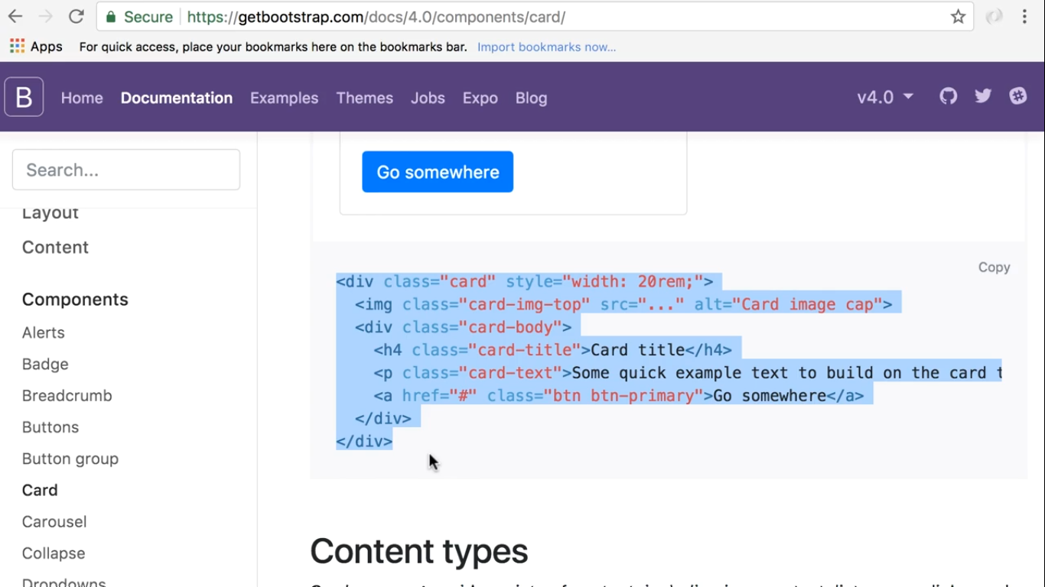

Slide 3
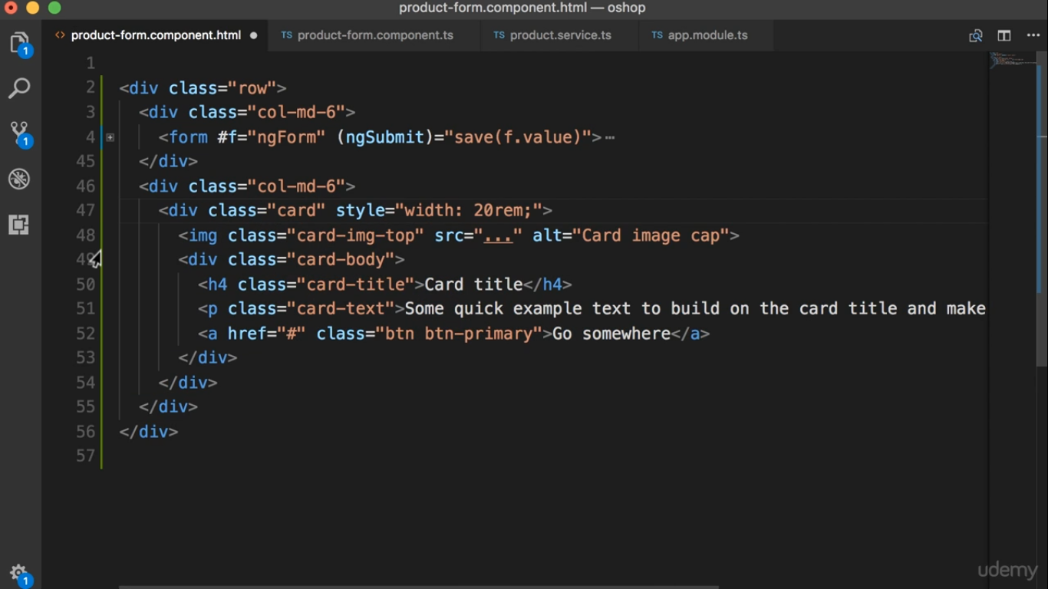

Slide 4
